Slide 1
Computer Networks

Slide 2
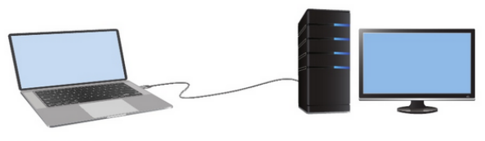
What is a Computer Network?
A network is a collection of two or more devices that are connected together to share resources, exchange data, and communicate with each other.

Slide 3
Host / End Device?
All devices that are connected to a network and participate directly in network communication are classified as hosts.
Hosts are also called end devices.
Example: Computers, Servers, Smartphones, Printers, and etc.

Slide 4
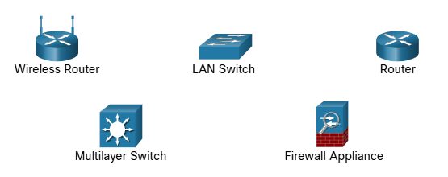
Intermediary Devices
Network devices that connect hosts and help manage the flow of data across the network.
They do not generate or consume data like end devices, but instead forward, direct, and control data traffic between devices.

Slide 5
Intermediary Devices
Forward data to the correct destination
Determine the best path for data to travel
Filter and secure traffic (Ex: firewalls)
Connect different networks together

Slide 6
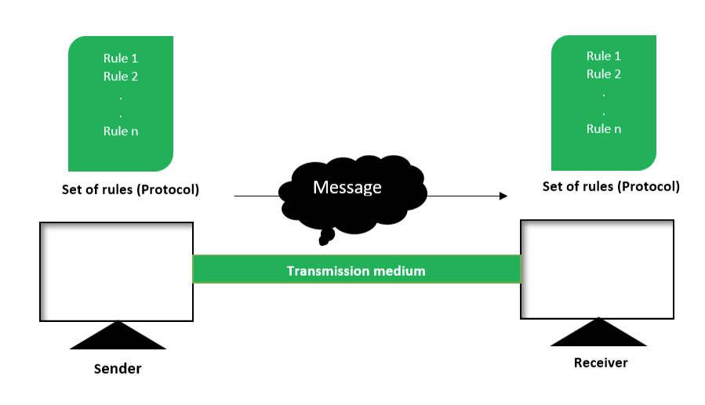
Components of Data Communication System

Slide 7
1. Sender
The device that initiates (sends) the data.

Slide 8
2. Receiver
The device that receives the data.

Slide 9
Question:
Is the client always the sender and the server always the receiver?

Slide 10
Client?
A client is a type of host that requests services from another device. Clients use software to request and display information received from servers.

Slide 11
Server?
A server is a type of host that provides services to other devices. Servers run software that allows them to provide information and services, often to multiple clients simultaneously.

Slide 12
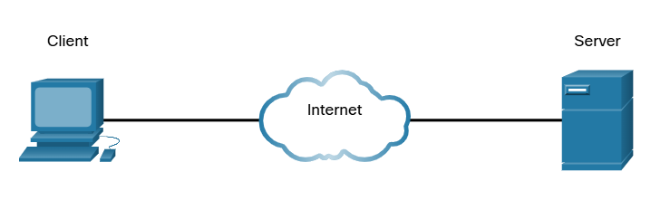

Slide 13
Answer:
No
A client and a server can both act as sender or receiver depending on the direction of communication. For example, when a client request data, it is the sender and the server is the receiver. When the server sends the requested data back, the server becomes the sender and the client becomes the receiver.

Slide 14
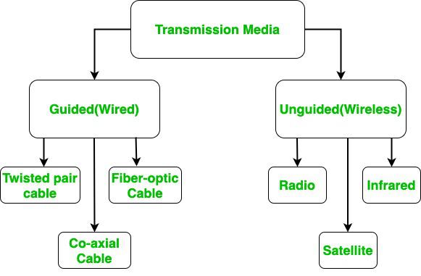
3. Transmission Media
Transmission media refer to the physical pathways through which data is transmitted from one device to another within a network.

Slide 15
Guided Media (Wired)
Data travels through a physical path such as cables.

Slide 16
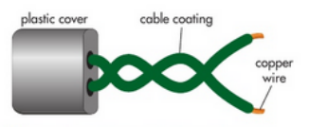
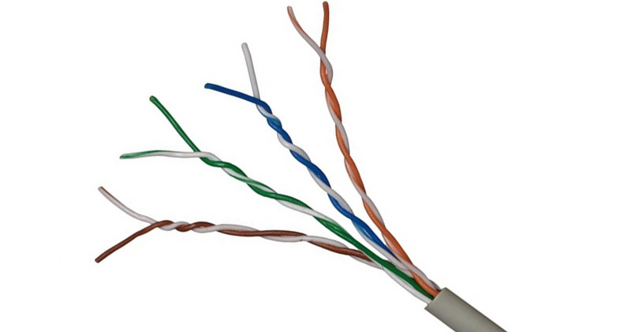
Twisted pair cable
A twisted pair cable is a type of copper cable that has two copper wires. Each copper wire has an insulated layer. The two copper wires are twisted around each other, and there is an outer plastic layer covering them.
Characteristics of twisted pair cables.
They transmit data using electrical currents.
They can transmit data up to a speed of 10 Gbps.
They are cheap to manufacture.
They can suffer from electromagnetic interference, so are only used to carry data over short distances.
They are easy to install.
They are mainly used for telephone communications and for Ethernet connections in a local area network within one building.

Slide 17
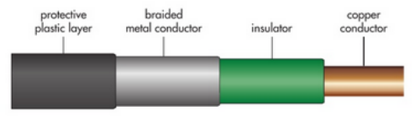
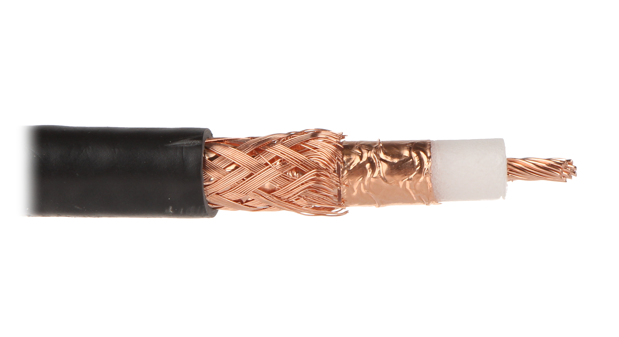
Coaxial cable
A coaxial cable is a type of copper cable. It has a central copper wire that has an insulated layer, a metal conductor layer and a protective plastic outer layer.
Characteristics of coaxial cables.
They transmit data using radio frequency signals.
They can transmit data at speeds of up to 10 Mbps.
They are cheap to manufacture, but not as cheap as twisted pair cables.
They are less prone to electromagnetic interference because of the braided metal conductor layer.
They are difficult to install, as they can be stiff and difficult to bend.
They are mainly used in cable TV connections and sometimes in internet connections.

Slide 18
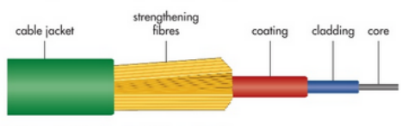
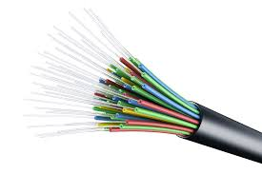
Fiber optic cable
A fiber optic cable has many very thin strands of glass or plastic that make up the core of the cable. The core is covered by a cladding, which is covered by a plastic coating. This plastic coating is covered by strengthening fibers and then an outer coating.
Characteristics of fiber optic cables.
They transmit data using light.
They can transmit data up to speeds of 1 Gbps.
They are expensive to manufacture.
They are not prone to electromagnetic interference.
They are difficult to install, as the cables can be fragile.
They are often used for internet connection and transmitting data over long distances.

Slide 19
Unguided Media (Wireless)
Data travels through the air (no physical connection) using electromagnetic waves.

Slide 20
Microwaves
A wireless communication method using high-frequency radio waves.
Transmits data through the air using antennas.
Can support very high speeds (Gbps range).
Requires line-of-sight between transmitter and receiver.
Can cover long distances.
More expensive due to towers and equipment.
Affected by weather conditions (rain, fog).
Commonly used in:
Satellite communication
Mobile networks
TV broadcasting
Point-to-point communication

Slide 21
Radio waves
They transmit data using electromagnetic waves.
They can travel long distances, even without line-of-sight.
They can penetrate walls and obstacles, unlike microwaves.
They support lower data rates compared to microwaves and fiber optics.
They are susceptible to interference from other devices and signals.
They are relatively low cost and easy to deploy.
They provide wide coverage areas.
They are mainly used in:
Radio broadcasting
Television broadcasting
Wireless communication (Wi-Fi, mobile networks)

Slide 22
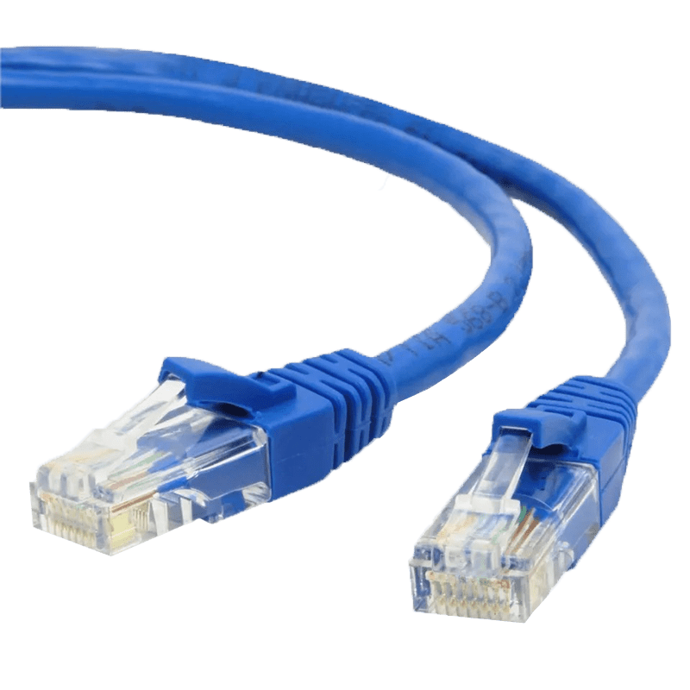
Ethernet
Ethernet is a wired networking technology used to connect computers, printers, routers, and other devices in a local area network (LAN). It (Ethernet protocol) defines how data is formatted, transmitted, and received over physical cables like Cat5e, Cat6, or fiber optic..
Ethernet cables can be coaxial, twisted pair or fiber optic.
LAN – Network that is located within a single building or site

Slide 23
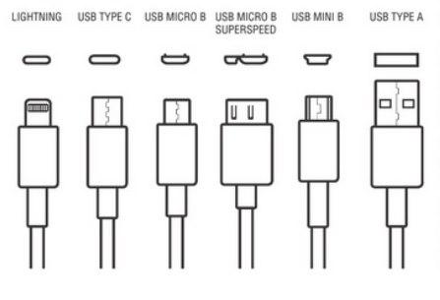
USB
A USB (Universal Serial Bus) is a standardized technology for connecting computers and electronic devices to transfer data and power.
USB has evolved through generations, from USB 1.0 to USB 3.0 and the latest USB4, offering faster transfer speeds and higher power capacity.

Slide 24
Question
What is NIC?

Slide 25
NIC?
NIC (Network Interface Card) is the hardware component that allows a device to connect to a network.
It acts as an interface between the device and the network, enabling the device to send and receive data.
NIC can be wired (Ethernet) or wireless (WNIC).
Modern computers usually have NICs built into the motherboard, Can add one if needed.
Every NIC has a unique identifier (MAC Address).

Slide 26
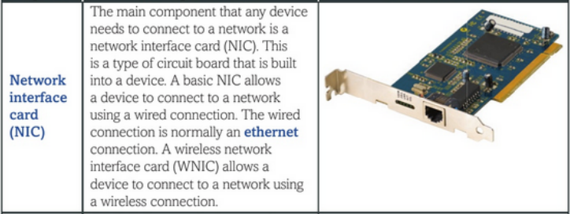
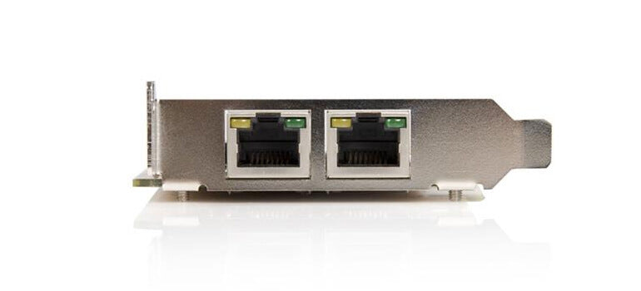

Slide 27
Question
Since MAC addresses must be globally unique, how do different vendors coordinate to make sure the same address is not assigned more than once?

Slide 28
Answer
Vendors don’t randomly generate MAC addresses. They are assigned in a structured way by a central authority called the IEEE.

Slide 29
How MAC addresses stay unique
A MAC address is 48 bits (like: 00:1A:2B:XX:XX:XX) and is divided into two parts:
1. OUI (Organizationally Unique Identifier) – first 24 bits
This part is assigned by IEEE.
Each vendor (like Intel, Cisco, Apple) buys/registers an OUI block. Example:00:1A:2B → belongs to one specific company
This means:No two vendors will have the same prefix
IEEE keeps a global registry of all assigned OUIs
2. Device-specific part – last 24 bits
This part is generated by the vendor
The vendor ensures no duplicates within their own devices

Slide 30
MAC Address
A MAC address can be used to identify a device in a network. The MAC address is assigned by the manufacturer of the device when it is being made. The MAC address is given to the NIC that is built into the device
Features of a MAC address:
Each address is unique.
It is written in hexadecimal.
It has 12 digits and the digits are grouped in pairs.
Each pair of digits is separated by a colon.
The first three pairs of digits are the manufacturer's ID.
The second three pairs are the serial number of the device.
Example - 3C:5A:B4:01:63:D2

Slide 31
4. Message
The actual data or information that is being communicated between the sender and the receiver. It can be in a text, images, audio, video files, depending on the type of communication.

Slide 32
Question
How data like text, images, or videos are send over a network?

Slide 33
The Bit
Computers and networks only work with binary digits.
Computers use binary codes to represent and interpret letters, numbers and special characters with bits.
Capital letter: A = 01000001
Number: 9 = 00111001
Special character: # = 00100011
Each group of eight bits, such as the representations of letters and numbers, is known as a byte.

Slide 34
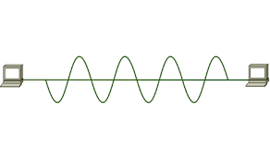
Signals
Bits are just abstract values. To send them from one device to another, we need to turn them into something that can physically travel.
A signal is a physical representation of a bit that can travel through a medium (like a wire or air).
At the receiver’s end:
Signals are converted back into bits, then interpreted as data.

Slide 35
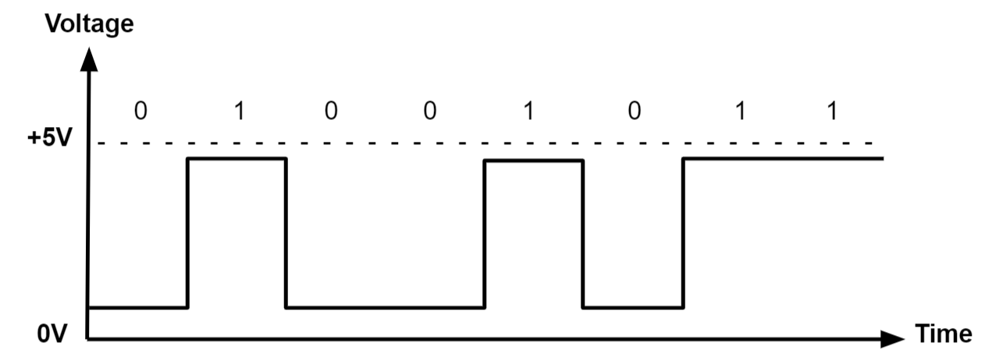
Digital Signals
Digital signals are discrete in value and time. These signals are represented by binary numbers and consist of different voltage values.
Digital signals are used in all digital electronics, including computing equipment and data transmission devices.

Slide 36
Digital Signals
Digital signals are transmitted as,
Electrical pulses in copper wires (like Ethernet cables), where voltage levels represent 0 and 1.
Light pulses in fiber optic cables, where light being ON or OFF represents 1 or 0.

Slide 37
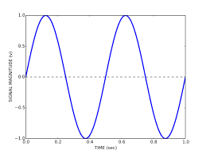
Analog Signals
An analog signal is a continuous electrical signal that varies in strength and frequency over time.
Unlike digital signals, analog signals can take on any value within a range.
Examples - sound waves, voltage fluctuations, and radio waves.

Slide 38
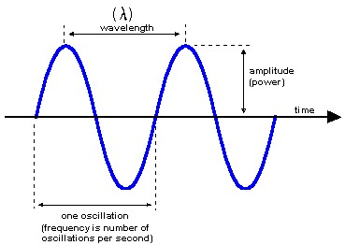
Characteristics of an Analog system

Slide 39

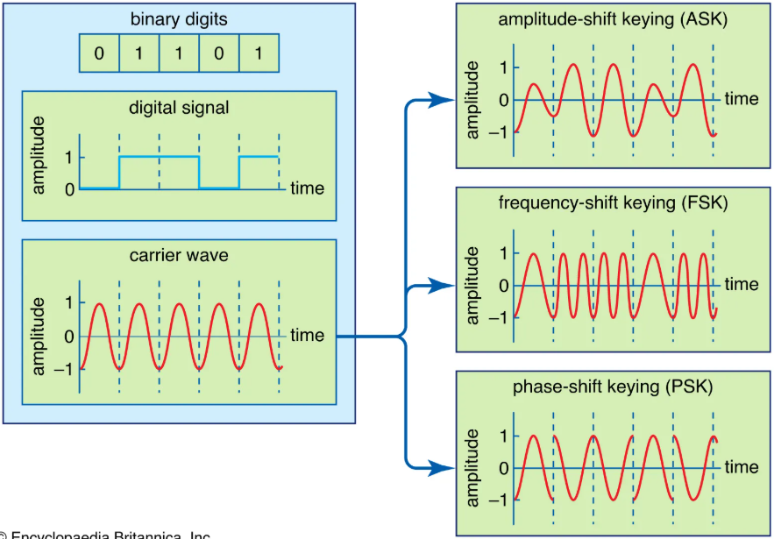
Modulation
Modulation lets us send digital data using analog waves.

Slide 40
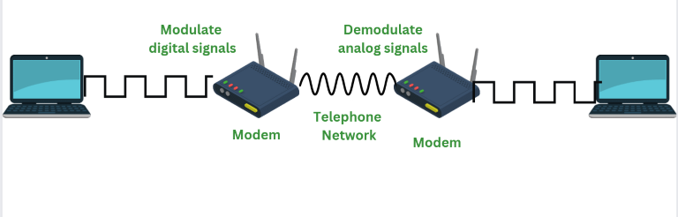
Modem
A modem is a device that connects your home to the internet by translating digital signals from your devices into analog signals that can travel over a network, and vice versa.

Slide 41
Answer
All types of data whether text, images, audio, or video are represented and stored as binary (1s and 0s) inside a computer. When this data is transmitted over a network, the binary bits are encoded into physical signals. In wired networks, they travel as electrical or light signals, and in wireless networks, they travel as radio waves. Every message we send is a stream of binary data transmitted as signals.
Cables: Data is encoded into electrical impulses.
Fiber-Optic: Data is encoded into pulses of light.
Wireless transmission: Data is encoded via modulation of specific frequencies of electromagnetic waves.

Slide 42
Question
How signals are generated?

Slide 43
Answer
A signal is generated by changing the strength (or any other property) of a particular form of energy with respect to time on a suitable medium.
Form of energy used can be Electrical, Light or Electromagnetic.

Slide 44
Bandwidth
Bandwidth is the maximum capacity of a channel.
Maximum amount of data that can be transmitted per second.

Slide 45
Throughput
Bandwidth is the maximum capacity of a channel.
Maximum amount of data that can be transmitted per second.

Slide 46
Question
Why Throughput < Bandwidth?

Slide 47
Answer
In real networks, we never achieve full bandwidth due to:
Network congestion (too many devices)
Packet loss & retransmissions
Protocol overhead (headers, control data)
Delays and interference
Actual data transfer (throughput) is always less than theoretical maximum (bandwidth).

Slide 48
Question
In wireless networks, throughput is much lower. Why?

Slide 49
Answer
Throughput in wireless networks is lower because multiple devices share the same medium, and signals are affected by interference, distance, and obstacles. This leads to errors and retransmissions, reducing the actual data transfer rate.

Slide 50
Data Transmission Rate (Bit Rate)
Number of bits send per second
Unit: bps

Slide 51
Baud Rate (Signaling Rate)
The number of signal changes/symbols per second.
Unit: baud

Slide 52
Question
Why Bit rate ≠ Baud rate (always)?

Slide 53
Answer
Because one signal (symbol) can represent more than one bit

Slide 54
Question
Calculate Data Transmission Rate?
Given:
Baud rate = 2400 symbols/sec
Each symbol = 2 bits

Slide 55
Answer
Bit rate = Baud rate × bits per symbol
= 2400 × 2
= 4800 bps

Slide 56
5. Protocol
Set of rules both sender and receiver must follow to ensure successful communication.

Slide 57
Question
Explain HTTP protocol?

Slide 58
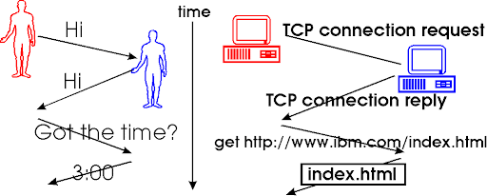
Answer
when your browser (the sender) sends a request to a website (the receiver) using HTTP (HyperText Transfer Protocol), the website’s server must also understand and respond using the same protocol. If both ends follow HTTP correctly, the browser can successfully load the webpage. If not, the communication will fail.
It’s just like two people speaking different languages without understanding each other.

Slide 59
Rules or Main aspects in HTTP
Request and Response format: Every communication in HTTP follows a specific format.
A request from the client includes a method.
GET: Retrieves data from the server.
POST: Sends data to the server, often to create or update resources.
PUT: Replaces a resource on the server with the data sent in the request.
DELETE: Deletes a resource on the server.
These methods guide what client wants and how the server should respond. So the client makes a “GET” request means,
It is asking the server to send back some data — As an example when you type a URL in your browser and press Enter, the browser sends a GET request to the server to fetch that page. Server process it and responds with the requested data, like an HTML file, and your browser displays it.
2. Status Codes
When the server responds, it includes a status code to indicate the result of the request. Examples include:
200 OK: The request was successful
404 Not Found: The requested resource doesn’t exist
500 Internal Server Error: A problem occurred on the server
These codes help the browser or client app understand what happened.

Slide 60
3. Headers
Headers provide extra information about the request or response, such as:
Content-Type: Tells what kind of data is being sent (e.g., HTML, JSON)
User-Agent: Identifies the browser
Authorization: Contains login credentials or tokens
Headers are key-value pairs that add context to the communication.
4. Statelessness
Also HTTP is stateless, meaning each request is treated independently. The server does not remember anything about previous requests from the same client.
Like HTTP we have other protocols.
FTP (File Transfer Protocol) - Used for transferring files between a client and server.
SMTP (Simple Mail Transfer Protocol) - Used for sending emails from a client to a mail server.

Slide 61
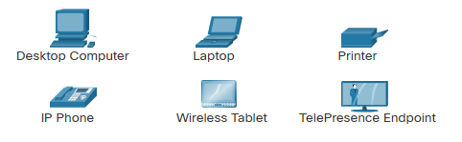
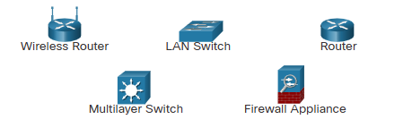
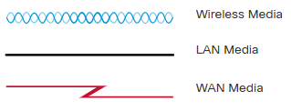
Network Infrastructure
The network infrastructure contains three categories of hardware components.
End devices
Intermediate devices
Network media

Slide 62
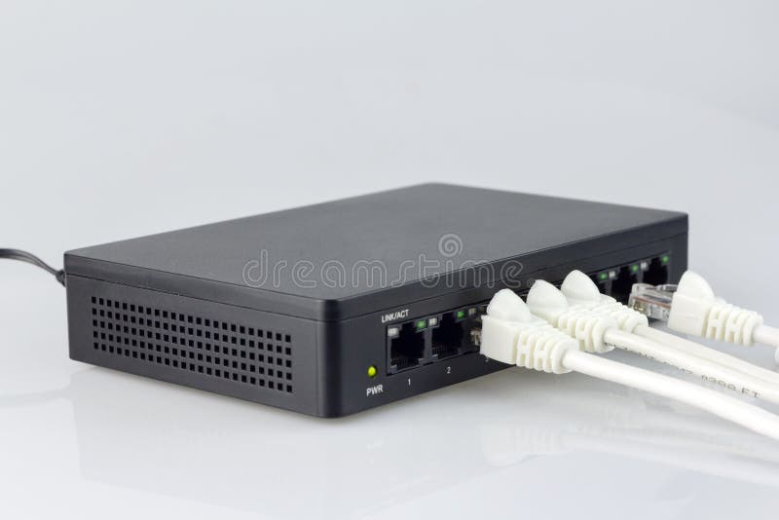
Hub
A hub is the most basic way of connecting several devices in a local area network (LAN).
A hub receives data packets and forwards them on to all devices that are connected to the hub. Only the intended destination device will accept the data sent; the other devices connected to the hub will just ignore it.
Each device is connected to a hub using a wired connection.
The type of wired connection normally used for a hub is either an ethernet connection or a USB connection.
There is a lot of unnecessary traffic in a network where hubs are used. This can cause a lot of data collisions, which can cause errors to occur and reduce the performance of the network.

Slide 63
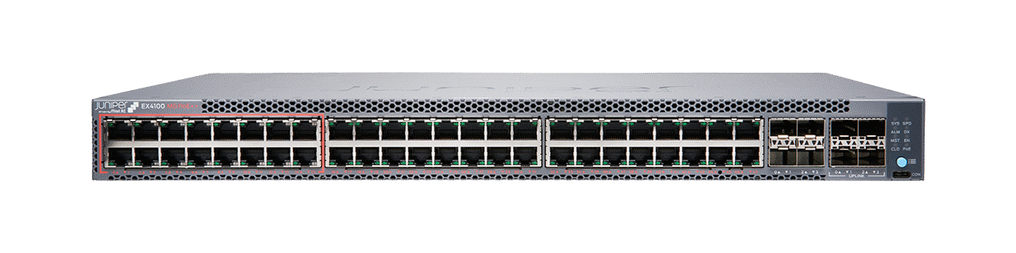
Switch
A switch was developed as an improvement to the inefficiency of a hub. A switch is also used to connect several devices in a LAN network.
Switch, only sends the data packets to the intended destination. It does this by using a device's media access control (MAC) address.
A switch records all the MAC addresses of devices that are attached to it and stores them in a table. It looks at the data packet to find the destination MAC address and forwards the data packet on to this device only.
This reduces the amount of traffic in the network and as a result reduces the number of data collisions. This improves the performance of the network.

Slide 64
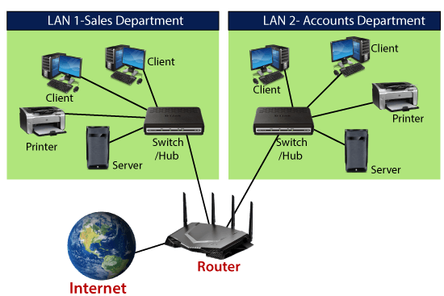
Router
A router is a device that connects different networks and forwards data based on IP addresses. In homes, it acts as a gateway between your LAN and the internet.
Switches and hubs are used to build and expand a LAN. A router is used to connect one LAN to another network, such as the Internet or another LAN.

Slide 65
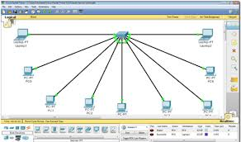
Activity: Install Packet Tracer

Slide 66
Types of Computer Networks
Computer networks can be classified according to their size.
Personal Area Network (PAN)
Local area network (LAN)
Metropolitan area network (MAN)
Wide area network (WAN)

Slide 67
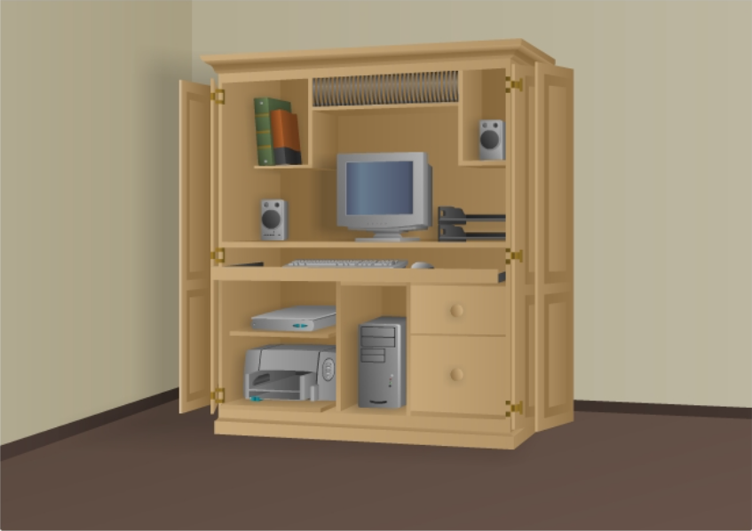
Personal Area Network (PAN)
The smallest type of network.
Usually covers only a few meters
Examples:
Connecting a mobile phone to wireless earbuds using Bluetooth.
Sharing internet from a phone to a laptop via a hotspot.

Slide 68
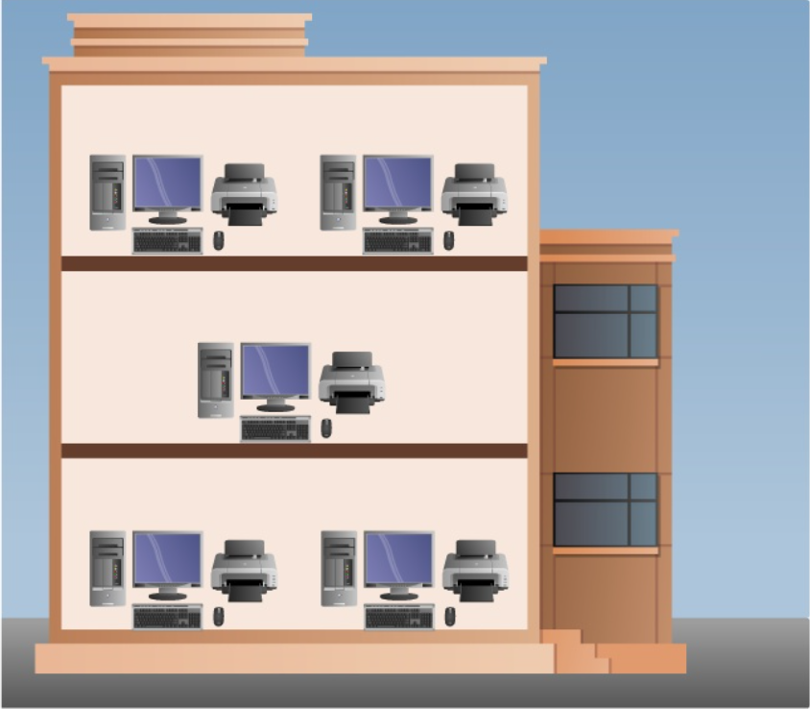
Local Area Network (LAN)
Covers a small geographic area such as a home, office, or school.
It connects devices like computers, printers, and servers within a limited space.
LANs provide high data transmission speed.
Usually privately owned and managed.
Enable the sharing of resources such as files or hardware devices that may be needed by multiple users.
Examples:
A computer lab in a school.
Office network.

Slide 69
Metropolitan Area Network (MAN)
Covers a larger geographic area such as a city or a large campus.
Formed by connecting multiple LANs together.
Example:
City-wide internet service.
Cable television network in a city.

Slide 70
Wide area network (WAN)
Covers a very large geographic area such as countries or continents.
Connects multiple LANs and MANs using long-distance communication links.
Have higher delays compared to smaller networks.
Example:
The internet

Slide 71
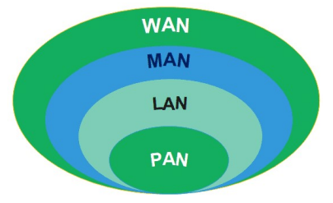

Slide 72
The Internet
The internet is a worldwide collection of interconnected networks.

Slide 73
ISP
An Internet Service Provider (ISP) is a company that provides access to the internet for residential, business, and mobile users, connecting them to the global network backbone via fiber, cable, DSL, or satellite.

Slide 74
Intranets
An intranet is a private network that is used within an organization. It is accessible only to authorized users such as employees.

Slide 75
Extranets
An extranet is an extension of an intranet that allows limited access to external users such as customers, suppliers, or business partners. It provides controlled access to certain parts of the organization’s network.

Slide 76
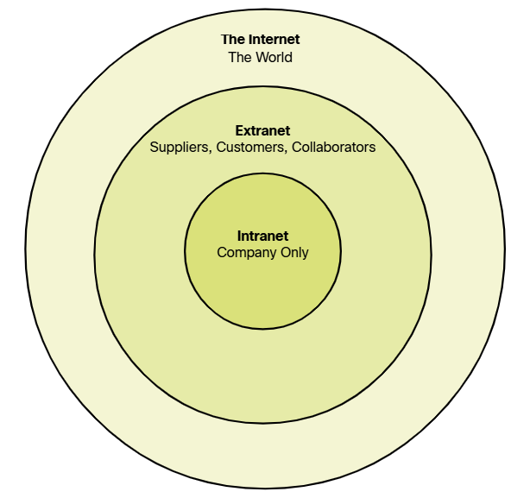

Slide 77
Creating a LAN
LAN’s can either be made wired or wireless.
Twisted pair, coax or fiber optic cable can be used in wired LAN’s.
Nodes are linked together with a certain topology.

Slide 78
Network topologies
The physical or logical arrangement of devices (hosts) and how they are connected to each other in a network.
Defines how data flows and how devices communicate.
There are two main types of topologies.
Physical Topology and Logical Topology

Slide 79
Physical Topology
The actual physical layout of cables and devices.
Shows how devices are physically connected.
Examples:
Bus, Star, Mesh, Ring, Tree, Hybrid

Slide 80
Star Topology
All devices are connected to a central device such as a switch or hub.
All communication passes through this central point.
Easy to manage and troubleshoot.
Failure of one device does not affect others.
If the central device fails, the whole network stops.

Slide 81
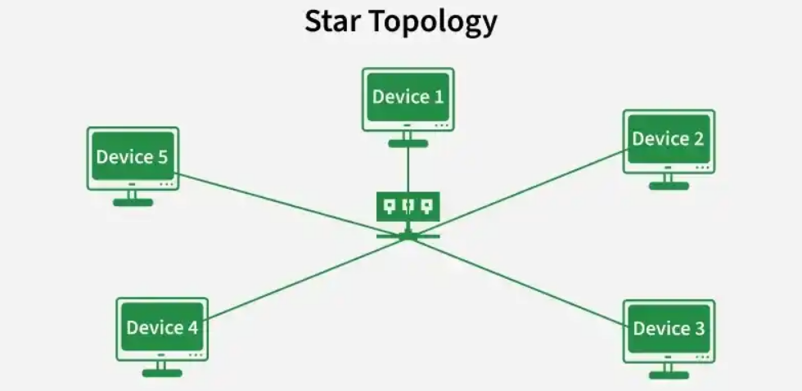

Slide 82
Bus Topology
All devices are connected to a single central cable called the backbone.
Data sent by one device travels along the cable and is received by all devices, but only the intended device processes it.
Simple and low-cost.
If the main cable fails, the entire network goes down.

Slide 83
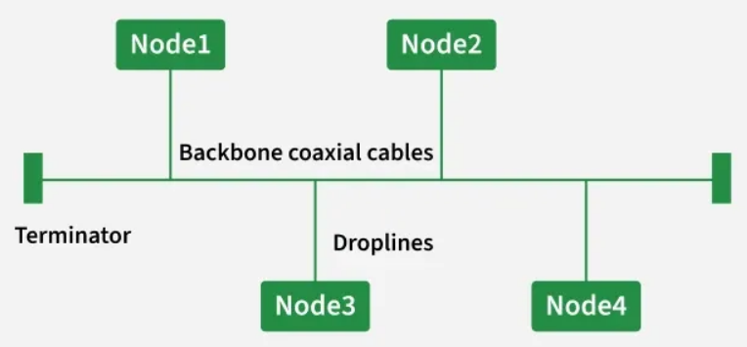

Slide 84
Ring Topology
Devices are connected in a circular manner where each device is connected to two others.
Data travels in one direction around the ring until it reaches the destination.
Provides orderly data transmission.
Failure in one device or connection can disrupt the entire network.

Slide 85
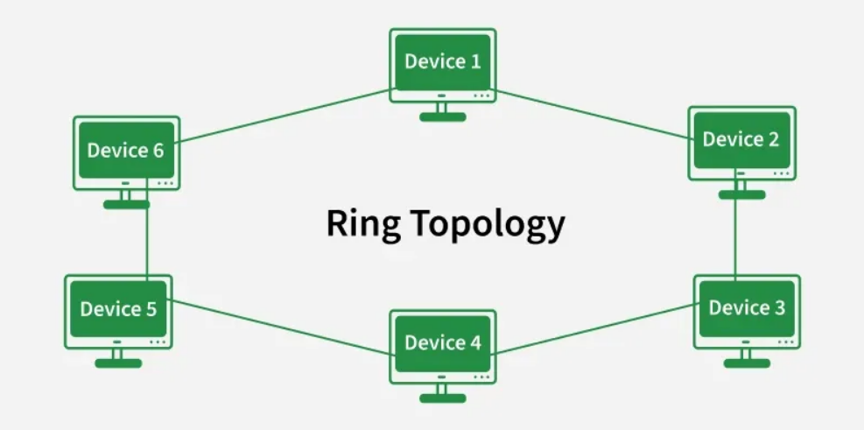

Slide 86
Mesh Topology
Each device is connected to multiple other devices.
In a full mesh, each device is connected to every other device.
Provides high reliability and multiple paths for data.
Expensive and complex to set up due to the large number of connections.

Slide 87
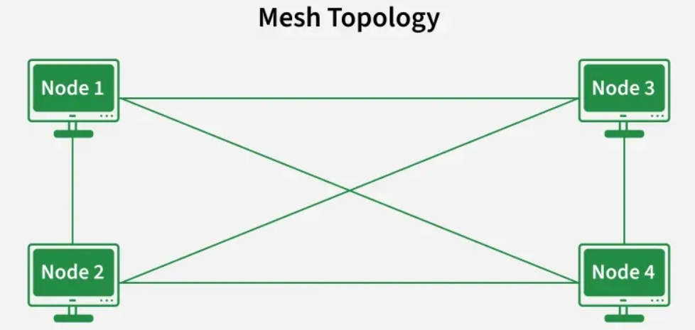

Slide 88
Tree Topology
A hierarchical structure that combines characteristics of star and bus topologies.
Has a root node and branches out to multiple levels of devices.
Scalable and suitable for large networks.
Failure of higher-level devices can affect many lower-level nodes.

Slide 89
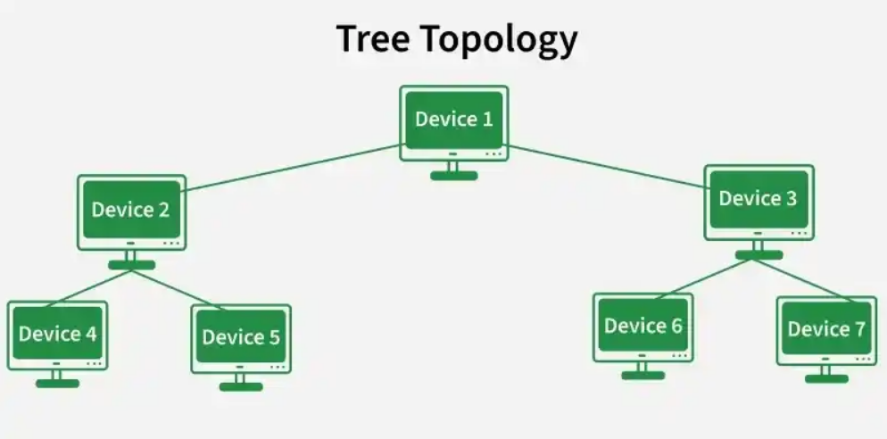

Slide 90
Hybrid Topology
A combination of two or more different topologies.
Example: star-bus, star-ring
Flexible and can be designed to meet specific network needs.
Can be complex and costly to implement and manage.

Slide 91
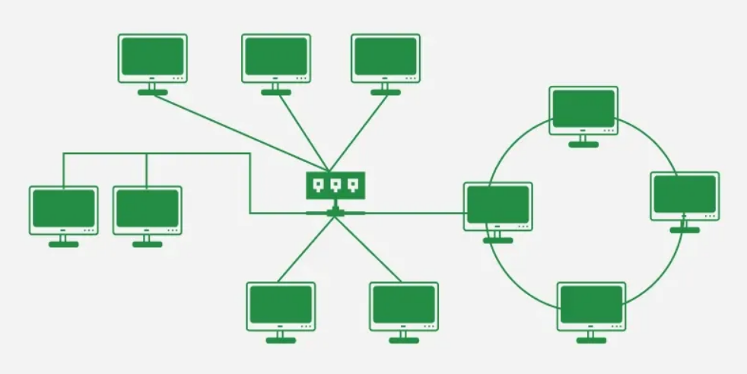

Slide 92
Logical Topology
Refers to how data actually moves across the network regardless of the physical layout.

Slide 93
Question
A network is physically arranged in a star topology but uses a hub. What is its logical topology?

Slide 94
Answer
The logical topology is Bus.
Because a hub broadcasts data to all connected devices. Similar to how data is transmitted in a bus topology.

Slide 95
Question
A network uses a switch and is arranged in a star topology. What is its logical topology?

Slide 96
Answer
The logical topology is Star.
Because switch sends data only to the intended destination device.

Slide 97
Question
Why is logical topology more important than physical topology in understanding network behavior?

Slide 98
Answer
Logical topology is more important because it defines how data flows between devices.
Network performance, efficiency, and troubleshooting depend on how data moves rather than how devices are physically connected.

Slide 99
Question
Design a network for a school computer lab that consists of 10 student computers, 1 teacher computer, and 1 network printer. All devices should be connected using a switch in a star topology to form a Local Area Network (LAN). The network must allow all computers to communicate with each other and share the printer.

Slide 100
Data Packets
When data transfers through a network, it is not sent as a single large block. Instead, it is divided into smaller units called packets.
Packets are transmitted separately across the network and may take different paths. At the destination, they are reassembled in the correct order to form the original message.
This method is called packet switching.

Slide 101
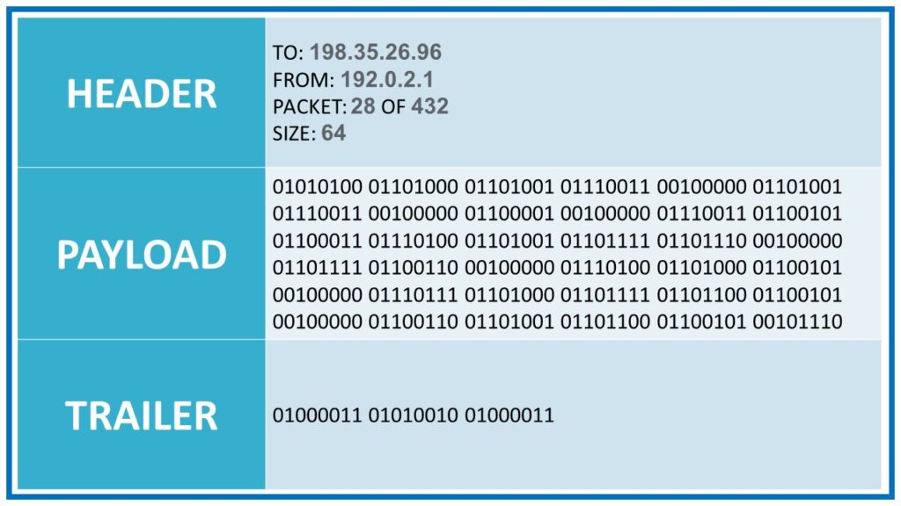
Data Packet
The unit of data that contains the information to be transmitted across a network

Slide 102
Circuit Switching
In circuit switching, a dedicated communication path is established between sender and receiver before any data is transmitted, and this path remains reserved for the entire session, even during idle periods.
Example: Traditional telephone systems.
This results in fixed delay and data arriving in order, but it is inefficient because bandwidth is wasted when no data is being sent.

Slide 103
Packet Switching
Packet switching breaks data into smaller packets.
Each packet travel independently across the network via different routes and be reassembled at the destination.
No dedicated path is reserved.
Network resources are used only when packets are actually transmitted.
Packet switching is more efficient and reliable.
Packet switching has variable delay. Packets may arrive out of order. Requires reassembly.
Packet switching is the foundation of the modern internet.

Slide 104
Question
Each device in a network has a unique MAC address assigned to its NIC. Is the MAC address alone sufficient for communication in all types of networks?

Slide 105
Answer
MAC addresses alone are not sufficient for communication across multiple networks. Because MAC addresses do not provide any information about the location or network to which a device belongs.
Cannot use MAC address to determine the path for data to travel.
Solution: IP Addresses

Slide 106
IP Address
An IP address (Internet Protocol Address) is a unique numerical identifier assigned to each device connected to a network that uses the Internet Protocol for communication.
IP address is use to uniquely identify a device on the network and to determine where the device is located in the network, so data can be sent to and from it.
IPV4 – 192.168.1.1
IPV6 - 2001:0db8:85a3:0000:0000:8a2e:0370:7334
The sender includes the destination IP address in the data packet. Routers use this IP address to forward the packet to the correct destination.

Slide 107
Layered Network Architecture
Layering is a technique used to divide network communication into multiple layers.
Each layer performs a specific function.
Layered network architecture was introduced to overcome the limitations of proprietary systems.

Slide 108
Proprietary Systems
In the early days of computing, different companies such as IBM, Apple, and Microsoft developed their own communication systems. These were known as proprietary systems because they were designed to work only with that company’s own hardware and software.
In proprietary systems, each manufacturer used its own rules, formats, and protocols for communication. As a result, devices from different vendors could not easily communicate with each other.
Example:
IBM systems could communicate only with other IBM systems
Apple devices could not easily connect with Windows-based systems

Slide 109
Question
How layered network architecture solves the problem of proprietary systems?

Slide 110
Answer
Layered network architecture solves the problem of proprietary systems by introducing standard rules at each layer of communication.
Instead of each company using its own complete system, all devices follow the same set of protocols at each layer.
This ensures that even devices from different manufacturers can communicate with each other, as they understand the same formats, addressing methods, and transmission rules.

Slide 111
OSI Model
The Open Systems Interconnection (OSI) model was developed by the International Organization for Standardization (ISO) to standardize communication between different computer systems.
OSI Model has 7 layers.

Slide 112
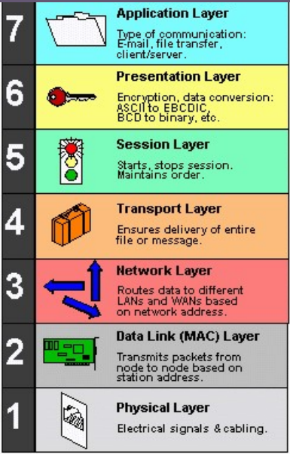

Slide 113
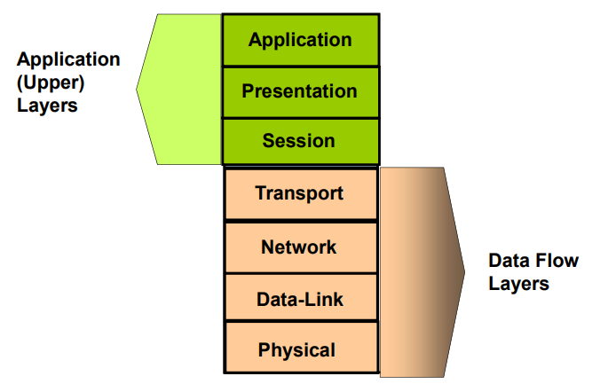

Slide 114
Application Layer:
Provides the interface for applications to access network services, such as email, file transfer, and web browsing.

Slide 115
Presentation Layer:
Handles data formatting, encryption, and compression to ensure compatibility between different systems.

Slide 116
Session Layer:
Manages communication sessions between applications, establishing, coordinating, and terminating connections.

Slide 117
Transport Layer:
Ensures reliable end-to-end delivery of data, including error detection and correction.

Slide 118
Network Layer:
Handles routing of data packets across networks, determining the best path for data to travel.

Slide 119
Data Link Layer:
Provides reliable transmission of data frames between two directly connected nodes.

Slide 120
Physical Layer:
Deals with the physical transmission of data over the network medium (e.g., cables, wireless signals).

Slide 121
Question
Imagine you are sending a message to your friend using WhatsApp on your phone while connected to Wi-Fi. Explain what happen the process with OSI model?

